Slide 1
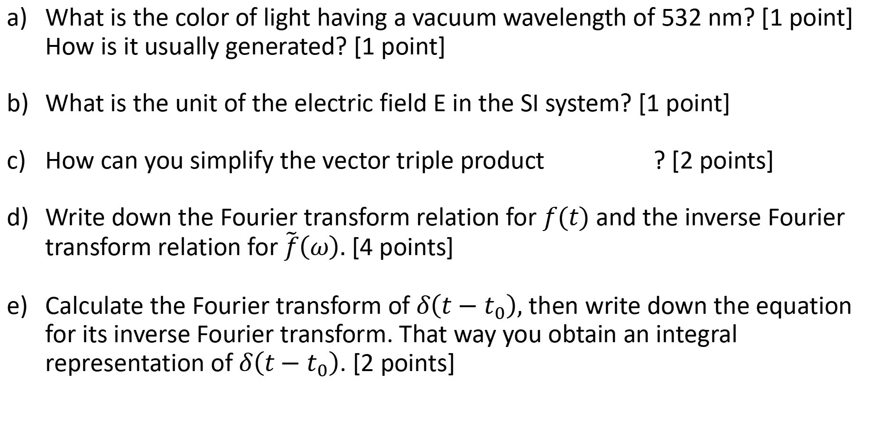
Quiz 1: Basics & Fourier Transform
What is the color of light having a vacuum wavelength of 532 nm? [1 point] How is it usually generated? [1 point]
What is the unit of the electric field E in the SI system? [1 point]
How can you simplify the vector triple product ? [2 points]
Write down the Fourier transform relation for $f(t)$ and the inverse Fourier transform relation for $\tilde{f}\left(ω\right).$ [4 points]
Calculate the Fourier transform of $δ\left(t−t_{0}\right),$ then write down the equation for its inverse Fourier transform. That way you obtain an integral representation of $δ\left(t−t_{0}\right)$. [2 points]
20 October 2022
You have 10 minutes.

